Slide 1
A Deep Dive into Nagios Analytics
Alexis Lê-Quôc (@alq)
http://datadoghq.com

Slide 2

@alq
Dev & Ops
Nagios user since 2008
Datadog co-founder

Slide 3
A little survey

Slide 4
Top 3 failed checks

Slide 5




Top 3 failed checks
That woke me up
That I responded to
5 weeks ago
That I responded to
last week
That impacts our business
the most?
That most of my team
responded to at least once

Slide 6





Top 3 failed checks
That woke me up
That I responded to
last week
That I responded to
5 weeks ago
That most of my team
responded to at least once
That impacts our business
the most?

Slide 7


Using memory to prioritize remediation...
At best, finding local optimums
At worst, brownian motion

Slide 8
Analytics

Slide 9





Performance Metrics
Nagios Traffic
Other Sources
In the “Cloud”

Slide 10
Nagios a “chatty” source out of 40+ Datadog supports

Slide 11
One example

Slide 12
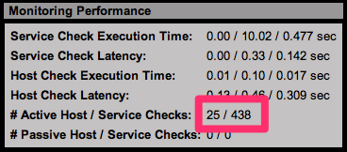

Slide 13
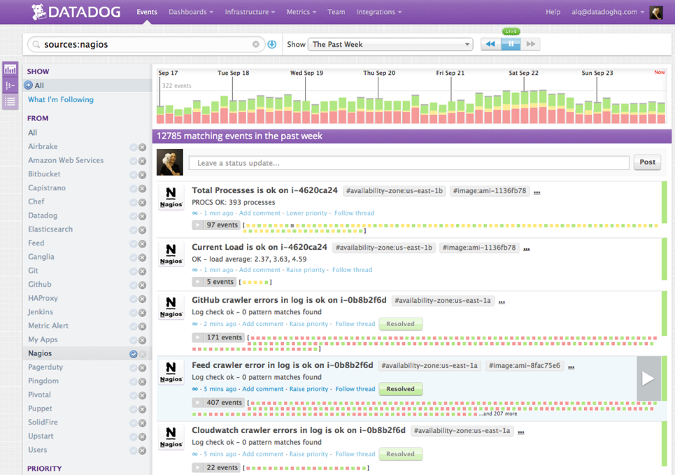

Almost 13000 Nagios “events”
over past week

Slide 14

Constant stream

Slide 15
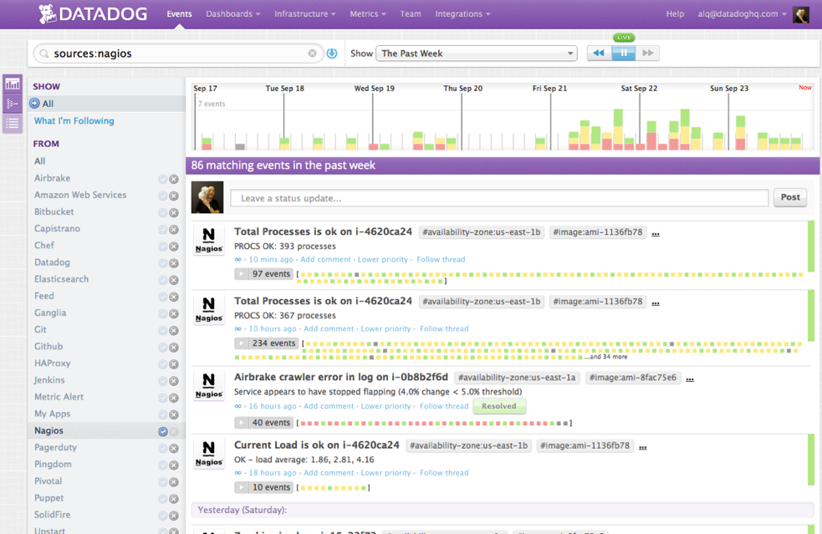

86 notifications!

Slide 16

Pattern

Slide 17

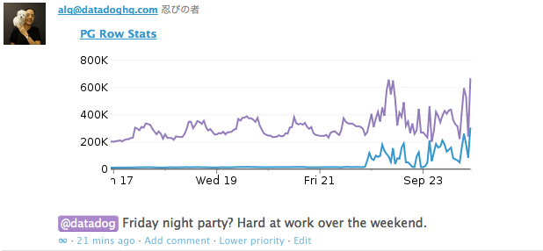
Pattern

Slide 18
More data?
More questions.

Slide 19

A dialog with data
Not a scientific study

Slide 20
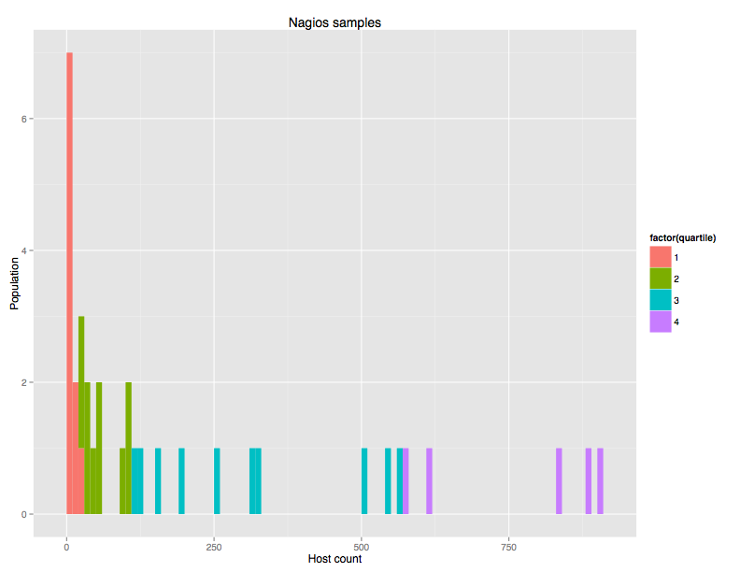


Population
25% 50% 75% 100%
20 93 322 904

Slide 21
Does size matter?

Slide 22
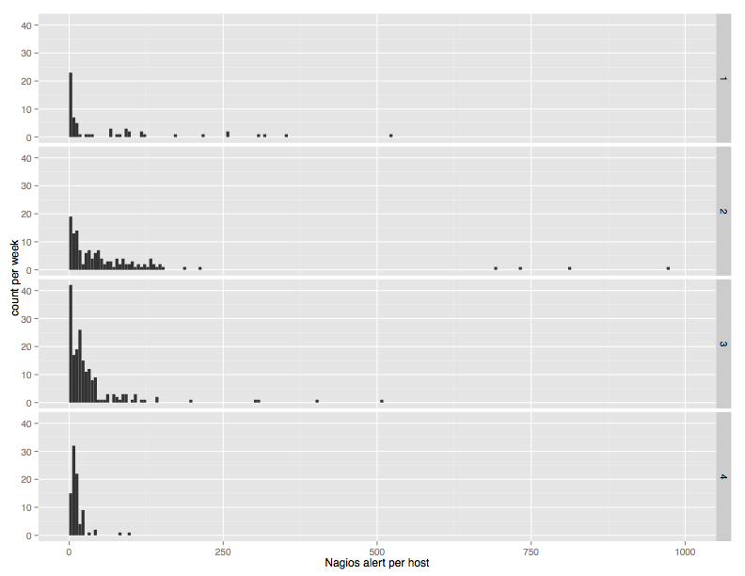
Weekly Count per host split by quartile

Slide 23

Weekly count per host split by quartile
Outliers
Sick hosts,
silenced checks

Slide 24
Notifications

Slide 25


Notifications
1-3% of alerts notify
Little difference per quartile

Slide 26
Does time of day matter?

Slide 27
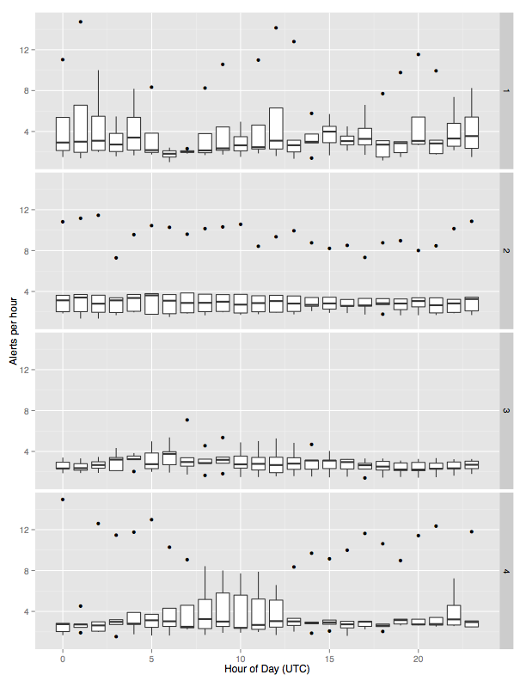

Slide 28


Mean about the same
across quartiles
Time-based deviation?

Slide 29
Does the day of week matter?

Slide 30
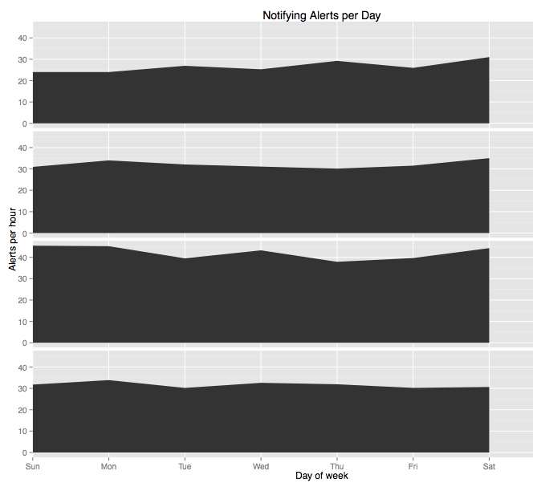

Slide 31

Not really

Slide 32
Squeaky wheels? (checks)

Slide 33
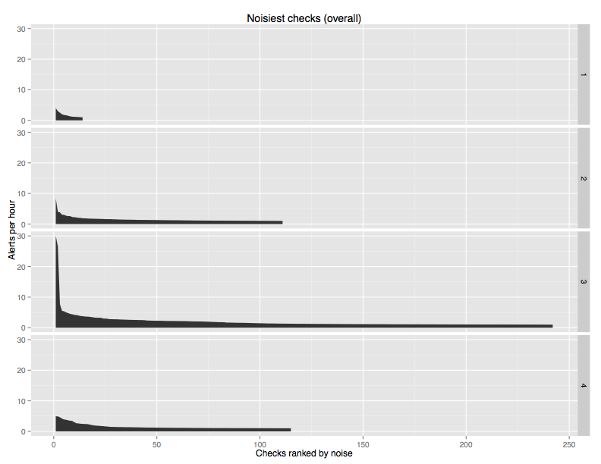

Outlier

Slide 34
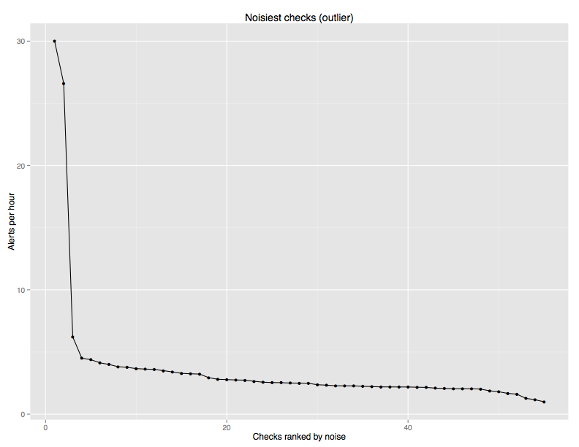

Outlier in more detail

Slide 35
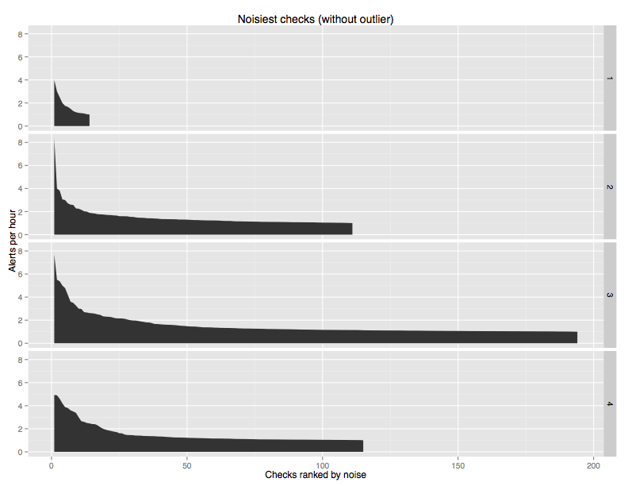

Long Tail

Slide 36
Squeaky wheel?
(hosts)

Slide 37
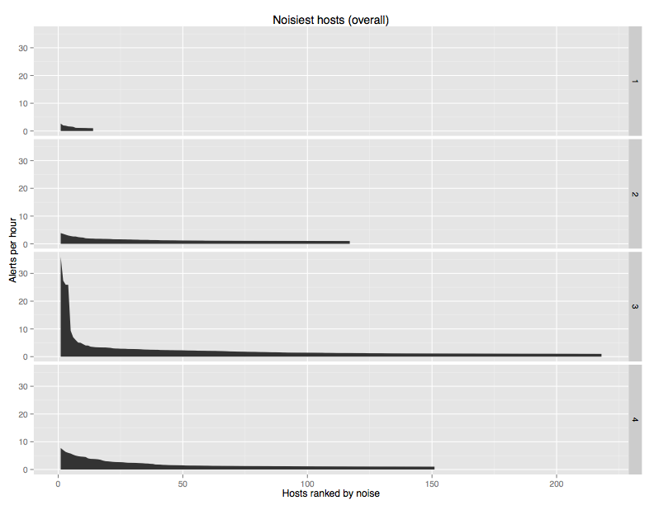

Same outlier

Slide 38
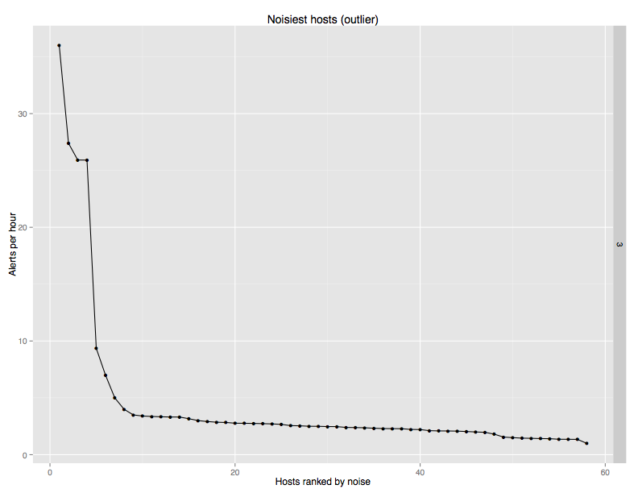

Similar pattern as checks

Slide 39
Long Tail

Slide 40
Recurring alerts

Slide 41
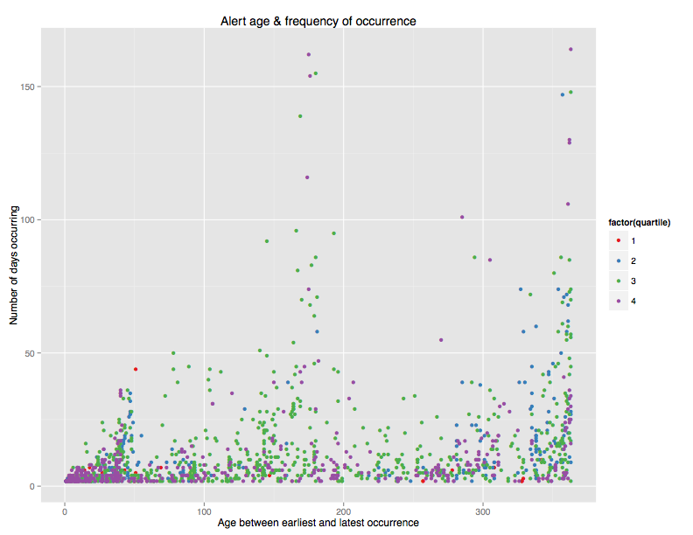



Happens
Often
Seldom happens
Young
Old

Slide 42



Occur often, for a long time
Tolerated
Happen once in a while

Slide 43
More data?
More questions.

Slide 44
HOWTO?

Slide 45




Find out tomorrow!
Awk
R
d3
Postgres

Slide 46
Presentation matters

Slide 47
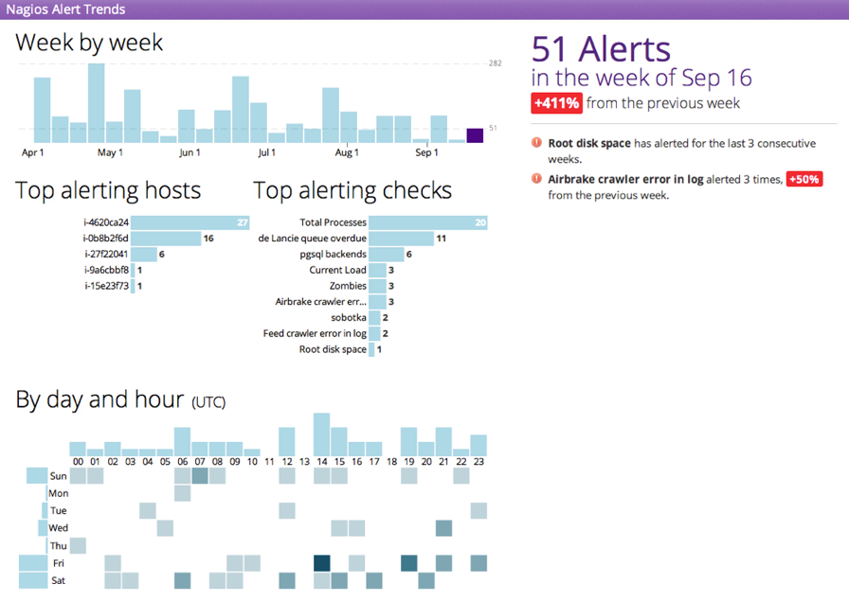

Slide 48
Take-away?

Slide 49
Take-aways
Don’t rely on your memory
Your Nagios logs are a treasure trove
Have a dialog with your data
Presentation matters

